Slide 1


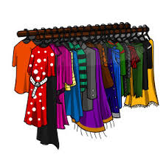


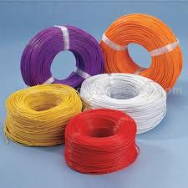

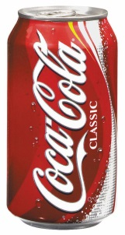

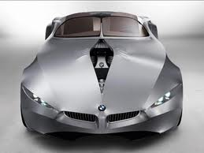
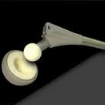
Historical perspective :
Materials are probably more deep-seated in our culture than most of us realize.
transportation
housing
communication
clothing
food conservation
virtually every segment of our everyday lives is influenced to one degree or another by materials

Slide 2
Historical perspective :
The development and advancement of civilizations have been closely tied to the members’ ability to produce and manipulate materials to fill their needs.
An extremely brief historical overview
Paleolithic (40,000 to 100,000 yrs ago): Stone tools and clay pots
• Mesolithic (10,000 to 40,000 yrs ago): Extensive use of stone tools and clay, stone statues, ochre (pigment)
• Copper Age (5,000 to 10,000 yrs ago): Copper ornaments, earthenware, metal smelting
• Bronze Age (3,000 to 5,000 yrs ago): Bronze (Cu/Sn), glass, iron smelting
• Iron Age (1000 – 3000 yrs ago): Carburized Iron, improved forging, porcelain
• Steel and concrete (100 – 1000 yrs ago)
• Polymers (beginning early 1900s)
• Silicon (60s – )
• The present: Age of bio- and nanomaterials?
Materials can define society

Slide 3
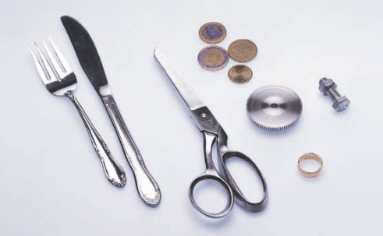
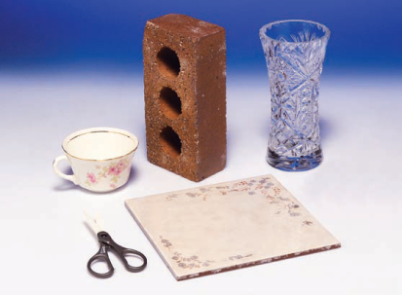
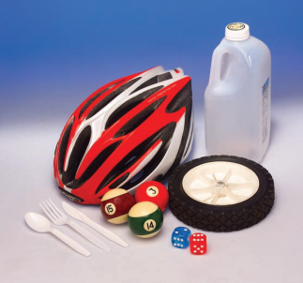
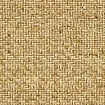
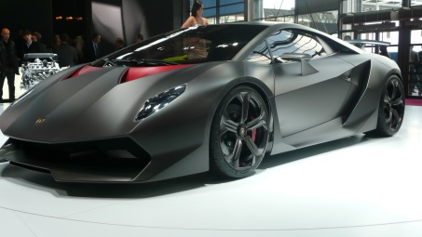


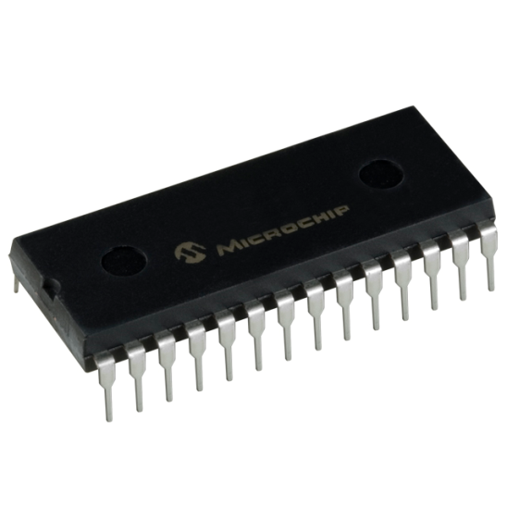
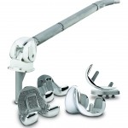
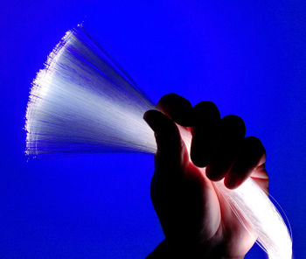
CLASSIFICATION OF MATERIALS
(chemical makeup and atomic structure)
Metals
Ceramics
Polymers
Composites (engineered combinations of two or more different materials)
Advanced materials — those used in high-technology applications, such as semiconductors, biomaterials, smart materials, and nanoengineered materials

Slide 4
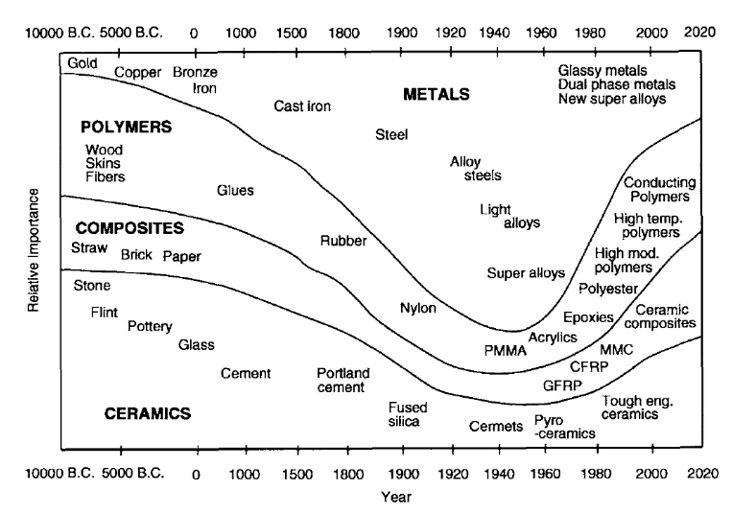
Relative importance of material development through history

Slide 5
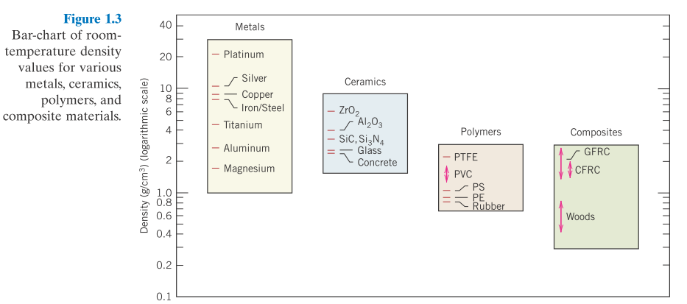
1. Metals
Materials in this group are composed of one or more metallic elements (e.g., iron, aluminum, copper, titanium, gold, and nickel), and often also nonmetallic elements (e.g., carbon, nitrogen, and oxygen) in relatively small amounts.
Atoms in metals and their alloys are arranged in a very orderly manner
Dense
Strong
Ductile
High thermal & electrical conductivity
Opaque
Reflective
Dense

Slide 6
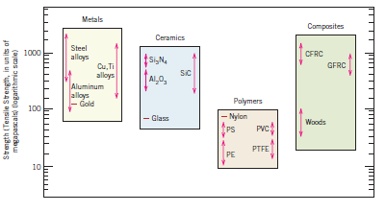
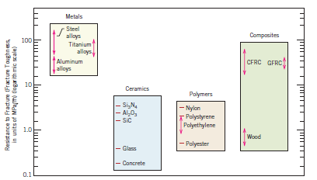
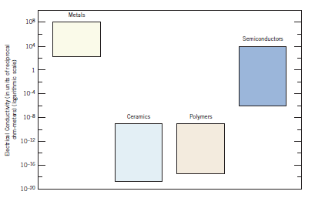
1. Metals
Strong/stiff
ductile
Some of the metals (i.e., Fe, Co, and Ni) have desirable magnetic properties.
High thermal & electrical conductivity

Slide 7
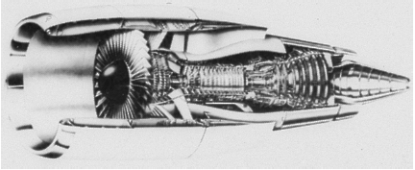
1. Metals and Alloys
An alloy is a mixture or solid solution composed of metals
designed to improve a desirable property (e.g. Steels, aluminum, magnesium, zinc, cast iron, titanium, copper, nickel, etc.)
A section of a jet engine.
The forward compression section operates at low to medium temperatures, and titanium parts are often used. The rear combustion section operates at high temperatures and nickel-based superalloys are required. The outside shell experiences low temperatures, and aluminum and composites are satisfactory. (Courtesy of GE Aircraft Engines.)

Slide 8
1. Metals and Alloys
Metals and Alloys | Examples of Applications | Properties
Copper | Electrical conductor wire | High electrical conductivity, good formability
Gray Cast Iron | Automobile engine blocks | Castable, machinable, vibration-damping
Alloy Steels | Wrenches, automobile chassis | Significantly strengthened by heat treatment

Slide 9
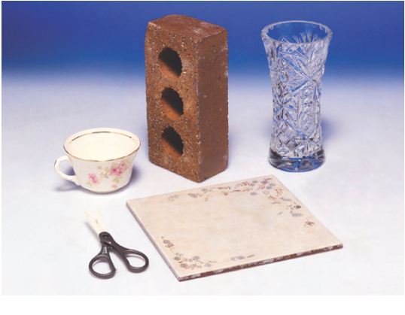
2. Ceramics
Ceramics are compounds between metallic and nonmetallic elements.
They are most frequently oxides, nitrides, carbides and borides.
For example, aluminum oxide (or alumina, Al₂O₃), silicon dioxide (or silica, SiO₂), silicon carbide (SiC), silicon nitride (Si₃N₄), and, in addition, the traditional ceramics—clay minerals (i.e., porcelain), as well as cement, and glass.
Hard but brittle (lack of ductility)
Low electrical and thermal conductivity
Excellent resistance to high temperatures
Have a number of unusual optical and electrical properties
Transparent, translucent, or opaque
ionic bonding (refractory)
Non-conducting (insulators)

Slide 10
2. Ceramics:
- Glasses and Glass-ceramics
Ceramics are inorganic crystalline materials.
Traditional Ceramics; bricks, tableware, sanitaryware
Advanced Ceramics; thermal barrier coatings, oxygen sensors, tiles for the space shuttle, also used in substrates that house computer chips, sensors and actuators, capacitors, spark plugs, inductors, and electrical insulation
Glass is an amorphous material – do not have a regular, periodic arrangement of atoms, and mostly derived from molten silica.
Used in cars, houses, computers, TVs, fiber optics
Glass-ceramics are heat treated (nucleation and crystallization) of glasses.
Used sealing applications, mirror substrates for large telescopes (e.g. Hubble telescope)

Slide 11
2. Ceramics, Glasses and Glass-ceramics
Ceramics and Glasses | Examples of Applications | Properties
SiO₂-Na₂O-CaO | Window glass or soda-lime glass | Optically transparent, thermally insulating
Al₂O₃, MgO, SiO₂ | Refractories | Thermally insulating, withstand high temperatures, relatively inert to molten
Barium titanate | Capacitors for microelectronics | High ability to store charge
Silica | Optical fibers for information technology | Refractive index, low optical losses

Slide 12
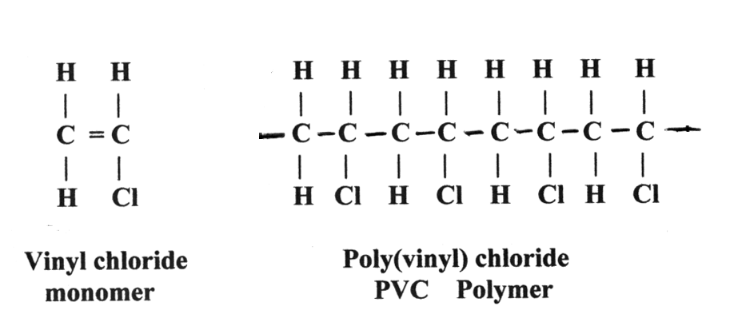
3. Polymers
Organic compounds produced by polymerization.
Chemically based on carbon, hydrogen, and other nonmetallic elements (i.e. O, N, and Si).
having very large molecular structures, often chain-like in nature with a backbone of carbon atoms.
Some of the common and familiar polymers are polyethylene (PE), nylon, poly(vinyl chloride) (PVC), polycarbonate (PC), polystyrene (PS), and silicone rubber.
Polymers include the familiar plastic and rubber materials

Slide 13


3. Polymers
Covalent bonding ⇨ sharing of e’s
Soft, ductile, low strength, low density
Low strength but have a good strength-to-weight ratio
Not suitable for use at high temperatures
Low electrical and thermal conductivity
Optically translucent or transparent.
Good resistance to corrosive chemicals
Electronic devices, bulletproof vests, CDs,
ropes, LCDs, etc.

Slide 14
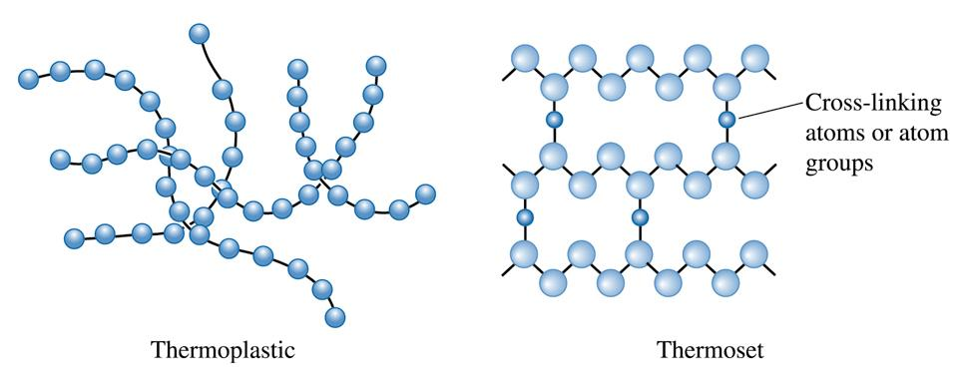
3. Polymers
Thermoplastics (long molecular chains are not rigidly connected) have good ductility and formability
Thermosets are stronger but more brittle because the molecular chains are tightly linked.
The term plastics is used to describe polymeric materials containing additives that enhance their properties
© 2003 Brooks/Cole Publishing / Thomson Learning™

Slide 15
3. Polymers
Polymers | Examples of Applications | Properties
Polyethylene | Food packaging | Easily formed into thin, flexible, airtight film
Epoxy | Encapsulation of integrated circuits | Electrically insulating and moisture-resistant
Phenolics | Adhesives for joining plies in plywood | Strong, moisture resistant

Slide 16
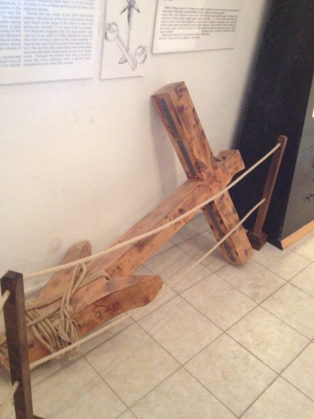
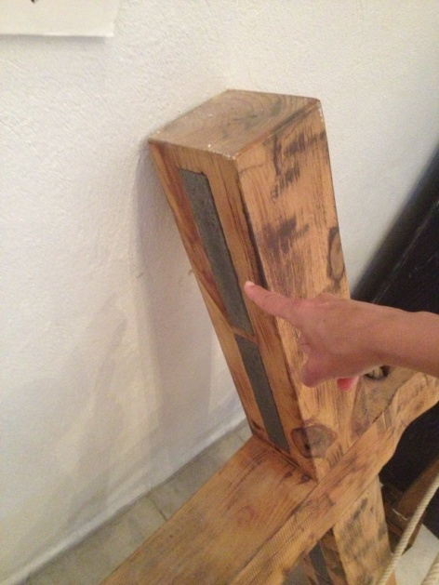

4. Composites
A composite is composed of two (or more) individual materials — metals, ceramics, and polymers.
The design goal of a composite is to achieve a combination of properties that is not displayed by any single material, and also to incorporate the best characteristics of each of the component materials.
Anchor
One of the most common and familiar composites is fiberglass
Fiberglass = Glass fiber + polymeric material
Small glass fibers are embedded within a polymeric material (normally an epoxy or polyester).
Thus, the resulting fiberglass is relatively stiff, strong, flexible, and ductile. In addition, it has a low density.

Slide 17
4. Composites
Possible to produce lightweight, strong, ductile, high temperature -resistant materials.
Composites | Examples of Applications | Properties
Graphite-epoxy | Aircraft components | High strength-to-weight ratio
Tungsten carbide-cobalt (WC-Co) | Carbide cutting tools for machining | High hardness, yet good shock resistance
Titanium-clad steel | Reactor vessels | Low cost and high strength of steel, with the corrosion resistance of titanium

Slide 18
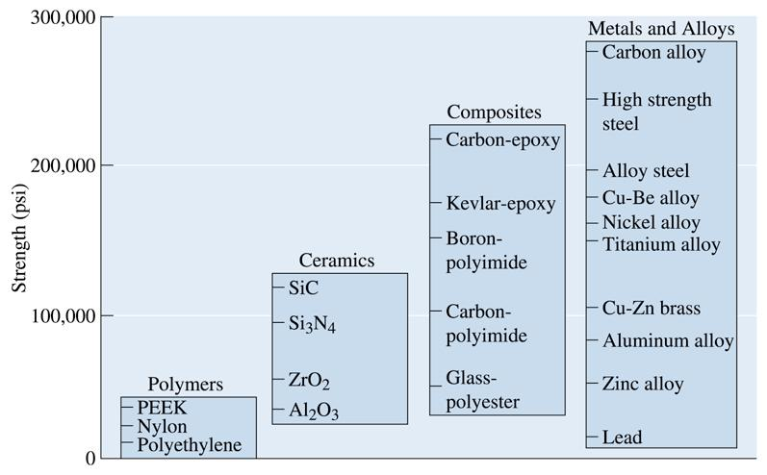
Strengths of various categories of materials
© 2003 Brooks/Cole Publishing / Thomson Learning™

Slide 19
Advanced materials
Materials that are utilized in high-technology (or high-tech) applications are called as an advanced materials.
High technological devices or products e.i.: electronic equipments (CD/DVD players, etc.), computers, fiber-optic systems, spacecraft, aircraft, and military rocketry so on…
These advanced materials are typically traditional materials whose properties have been enhanced, and also newly developed.
They may be of all material types (e.g, metals, ceramics, polymers), normally expensive.

Slide 20
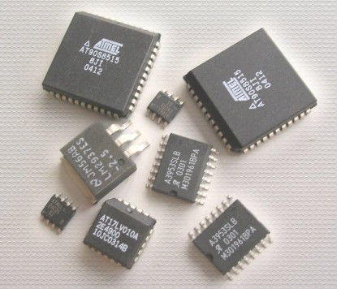
Advanced materials- Semiconductors
Semiconductors are part of a broader class of materials known as electronic materials.
Semiconductors have electrical properties that are intermediate between the electrical conductors (i.e., metals and metal alloys) and insulators (i.e., ceramics and polymers)
Silicon is used to create most semiconductors commercially. But, dozens of other materials are used, including germanium, gallium arsenide, and silicon carbide.
Semiconductors have made possible the beginning of integrated circuitry that has totally revolutionized the electronics and computer industries over the past three decades.

Slide 21
Advanced materials- Semiconductors
Semiconductors | Examples of Applications | Properties
Silicon (Si) | Transistors and integrated circuits | Unique electrical behavior
GaAs | Optoelectronic systems | Converts electrical signals to light, lasers, laser diodes, etc.

Slide 22
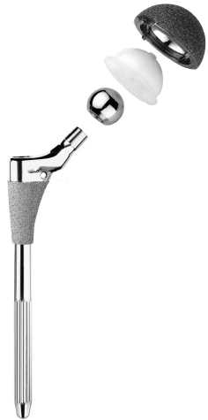
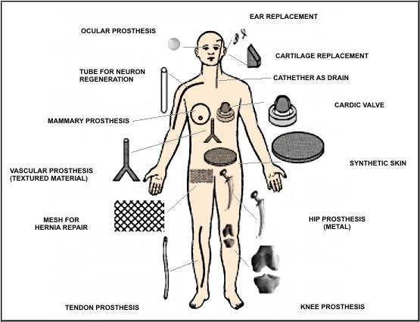
Hip Implant
Advanced materials- Biomaterials
Biomaterials are the components implanted into the human body for replacement of diseased or damaged body parts.
not produce toxic substances
and must be compatible with body tissues (i.e., must not cause adversebiological reactions)
Ball
Acetabular
Cup and Liner
Femoral
Stem
metals, ceramics, polymers, composites, and semiconductors- may be used as biomaterials.

Slide 23
Advanced materials - Smart Materials
Smart (or intelligent) materials are a group of new and state-of-the-art materials now being developed that will have a significant influence on many of our technologies
These materials are able to sense changes in their environment and then respond to these changes in predetermined manners.
- Altering their shape, position, natural frequency, or mechanical characteristics in response to changes in temperature, electric fields, and/or magnetic fields
Example:
shape-memory alloys,
piezoelectric ceramics,
magnetostrictive materials,
electrorheological/magnetorheological fluids.

Slide 24
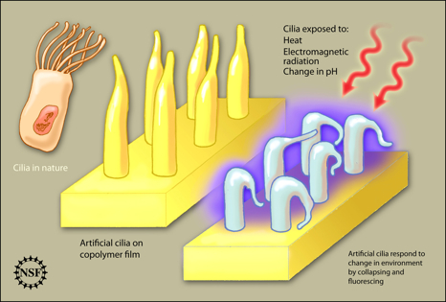
Advanced materials - Smart Materials
Artificial cilia respond to change in environment by collapsing and fluorescing

Slide 25
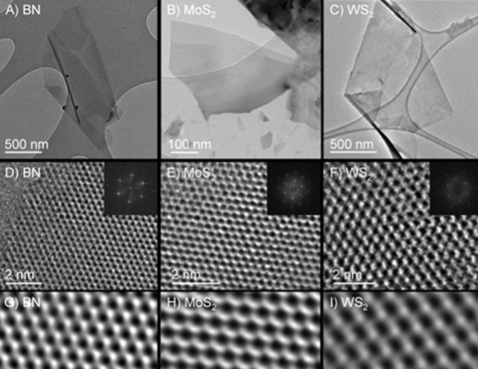
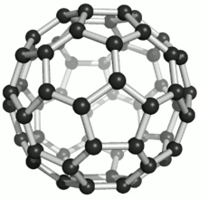
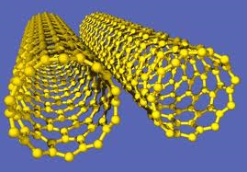
Advanced materials - Nanomaterials
Nanomaterials may be any one of the four basic types—metals, ceramics, polymers, and composites.
They are not distinguished on the basis of their chemistry, but rather, their size.
the nano-prefix denotes that the dimensions of these structural entities are on the order of a nanometer (10^{–9} m)—as a rule, less than 100 nanometers
nanometer = 10⁻⁹ m
Nanomaterials
Nanoparticles
Nanostructured Materials
Nanoclays and Nanocomposites
Nanocomposite Coatings
Nanotubes
Nanocatalysts
Nanofilters

Slide 26
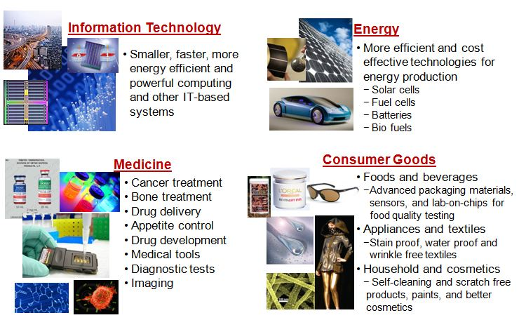
Nanotechnology Applications

Slide 27
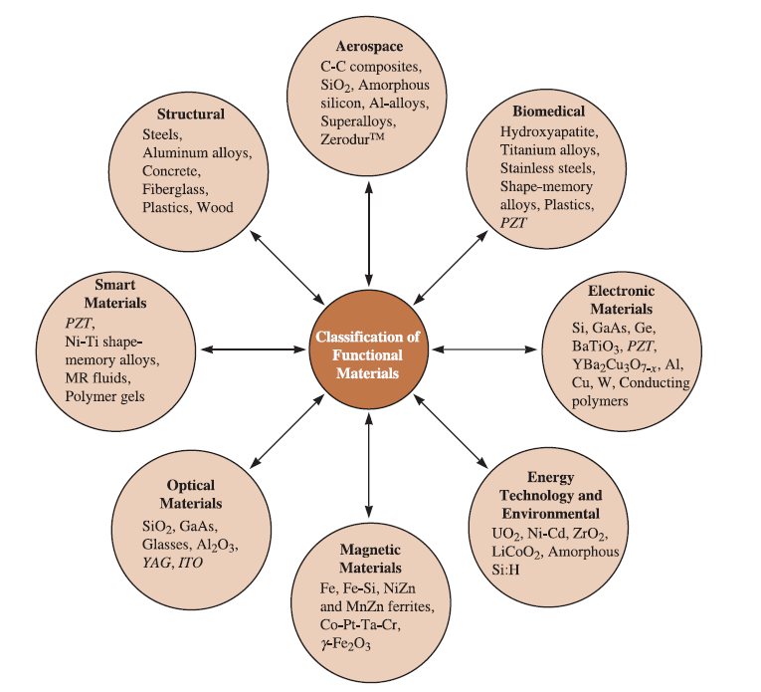
Notes:
We can classify materials based on whether the most important function they perform is
mechanical (structural), biological, electrical, magnetic, or optical.
PZT (lead zirconium titanate).
yttrium aluminum garnets (YAG)

Slide 28
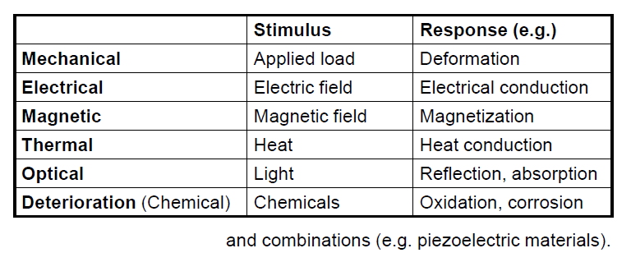
Properties of materials
To obtain desired properties, the material must have the appropriate structure.

Slide 29
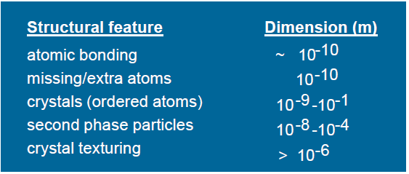
To obtain desired properties, the material must have the appropriate structure.
Structure
• Types of atoms.
• Arrangement of atoms/molecules.
– e.g. crystal structure, polymer chain length, crosslinking…
• Defects and impurities.
• Grain size.
• Etc…
Structure at different length scales:
Structure depends on processing conditions

Slide 30
To achieve performance needs, an understanding of materials’ properties is necessary!
To obtain desired properties, the material must have the appropriate structure.
Structure depend on processing conditions

Slide 31
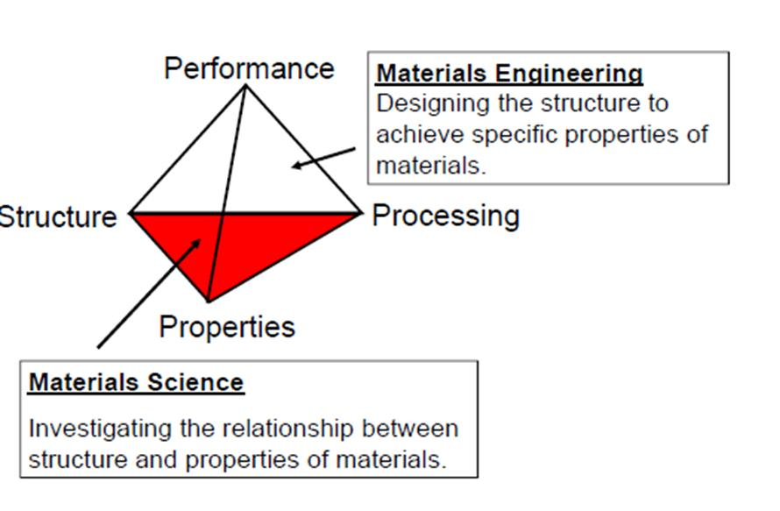
WHY STUDY MATERIALS SCIENCE
AND ENGINEERING?
Many applied scientist or engineer will at one time or another be exposed to a design problem involving materials.
relates to the arrangement of its internal
components
the structure of a material will depend on how it is processed
mechanical, electrical, thermal, magnetic, optical, and deteriorative.

Slide 32
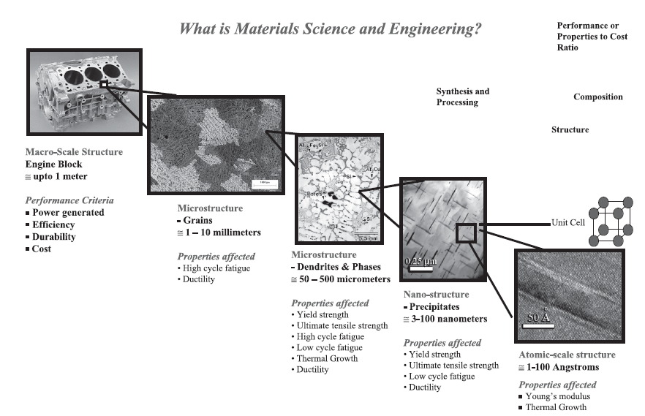
A real world example of important microstructural features at different length-scale.
The atomic, nano, micro and macro-scale structures of cast aluminum alloys in relation to the properties affected and performance are shown.

